Slide 1
WSSA 2022/23 Agenda
1. Welcome back and introductions
2. Apologies for absence
3. Minutes of last meeting and matters arising
4. Fencing opportunities for schools
5. The WSSA Explained
6. Calendar until Christmas 2022
7. NFL Flag Football
8. A.O.B

Slide 2
Worthing Schools’ Sports Association (WSSA) 2022-2023

Slide 3
Membership 2022/23
21 Schools have joined WSSA for 2022/23
Primary Schools – Goring, Heene, St Mary’s, Vale, West Park, Whytemead,Downsbrook, Elm Grove, Laurels, Broadwater, Bramber and English Martyrs
Junior Schools – TAB, Chesswood, Durrington and Orchards.
Infant Schools- Lyndhurst, Springfield, Durrington, Field Place and TAB Infants
Small schools ( 1 form entry) St Mary’s , Whytemead, Elm Grove, Laurels, English Martyrs

Slide 4
Wider Landscape
WSSA is part of the Southern Area Partnership (consisting of 6 cluster of schools – Worthing, Littlehampton, Angmering, Steyning, Shoreham and Lancing)
Southern Area Partnership is run by School Games Organiser Dan Jenner and is part of the Sussex School Games network (consisting of 9 partnerships)

Slide 5
Local Structure and Organisation
All WSSA members pay a fee based on the Govt formula for Sports Premium Funding
Steering group – Ali Groves , Tim Quick and Rachael Daniels.
Day to Day delivery Ali Groves based at TAB – 3 days week. ( Mon AM, Tuesday, Wed PM, Thursday)

Slide 6
Competitive Opportunities
Exclusive WSSA Events for KS1 and KS2
School Games Qualifier – WSSA event but has a further pathway
Festivals – focus on participation or particular aspect of learning
Disability events can be just WSSA or for schools in the Southern Area Partnership
Mass participation events:
Cross Country
Year 2 Legacy Games (13th and 15th June at Durrington Juniors)
Year 3-6 Legacy Games 21st June at Worthing Leisure Centre

Slide 7
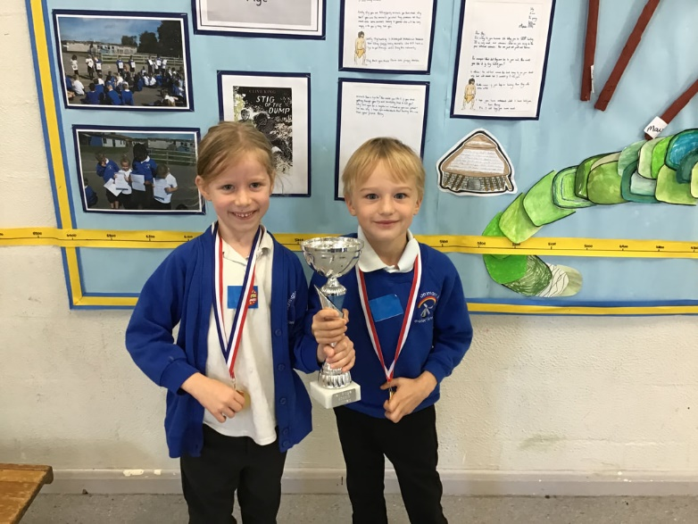
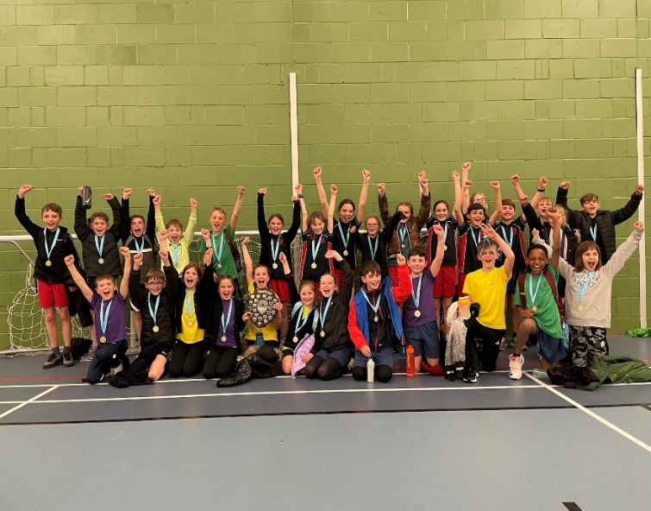
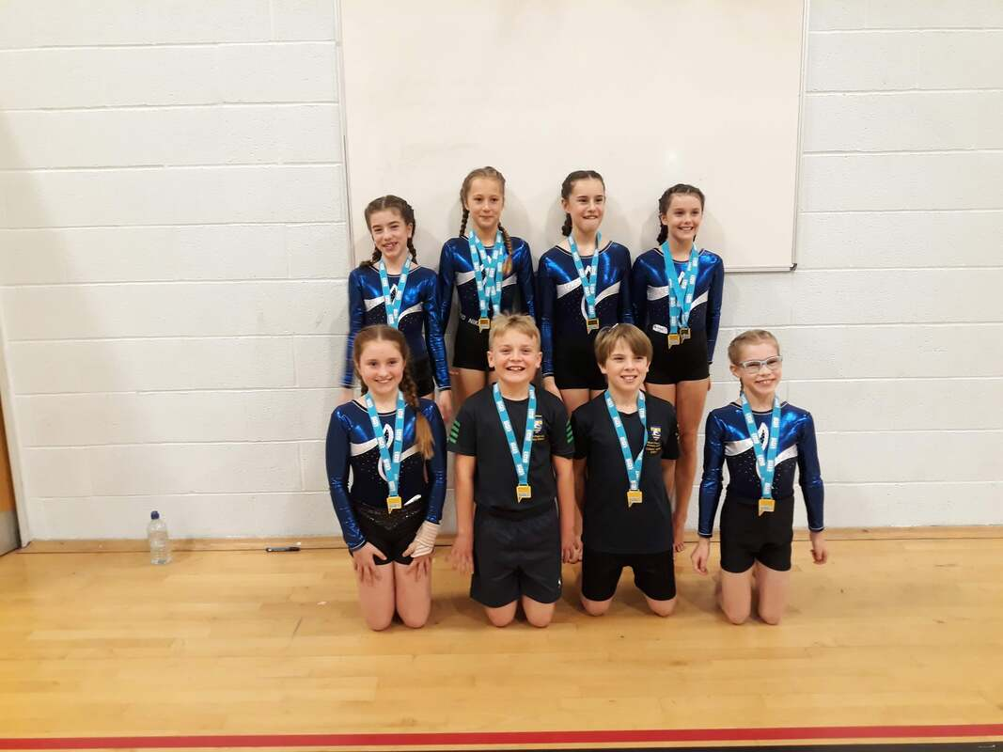
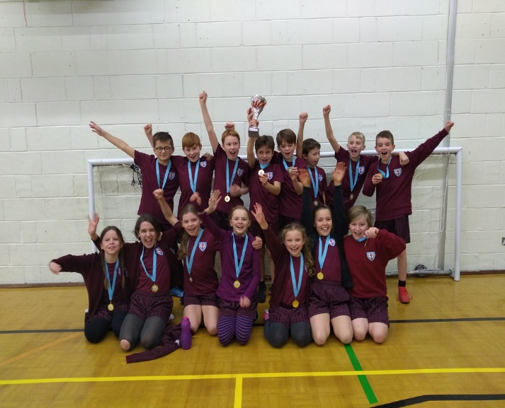
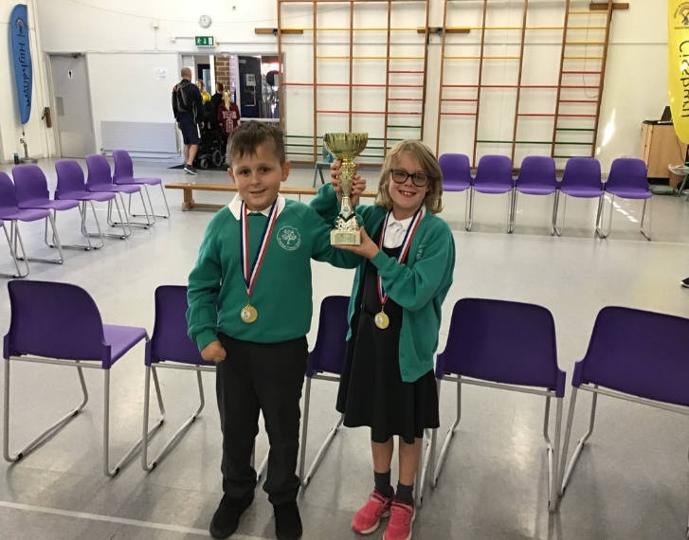
WSSA Success

Slide 8
WSSA Partnership Success

Slide 9
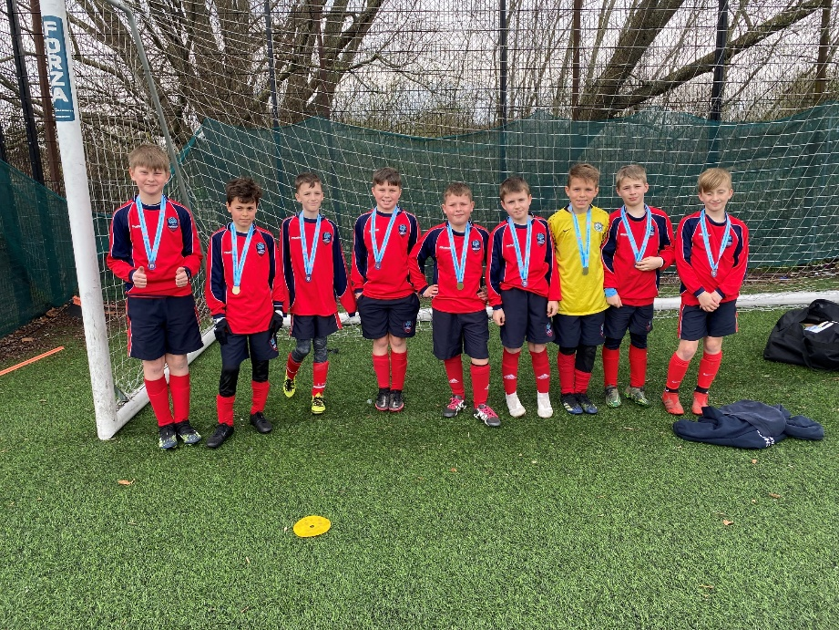
WSSA County Success

Slide 10
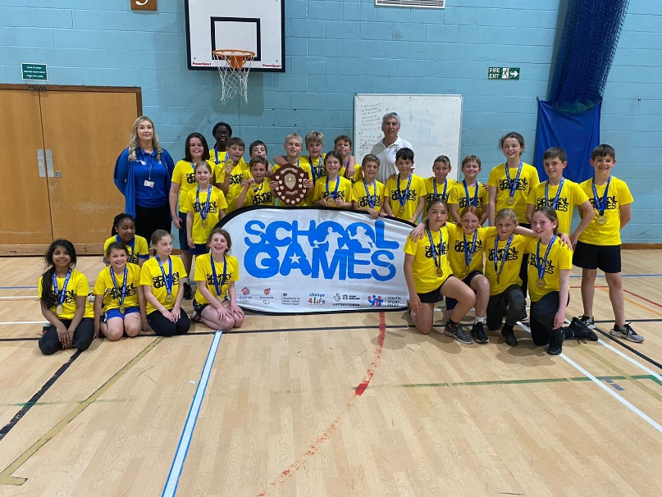
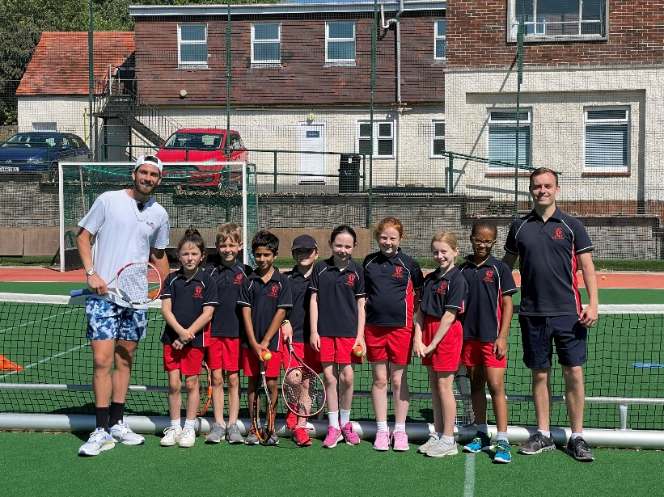
WSSA County Success

Slide 11
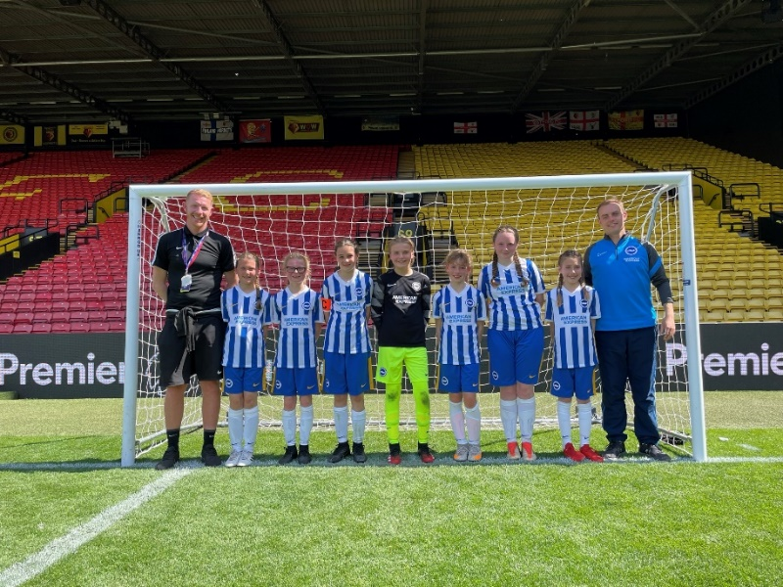
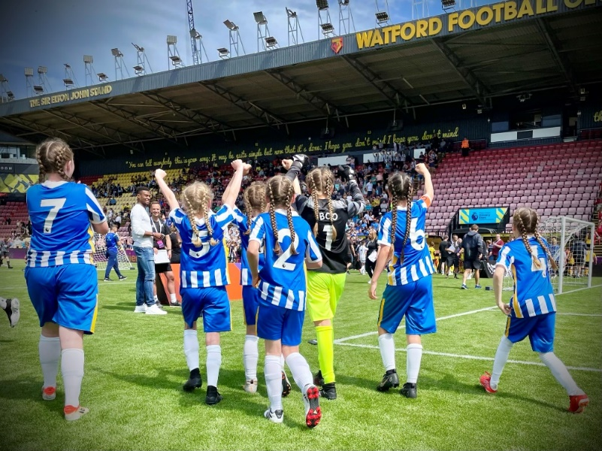
WSSA National Success

Slide 12
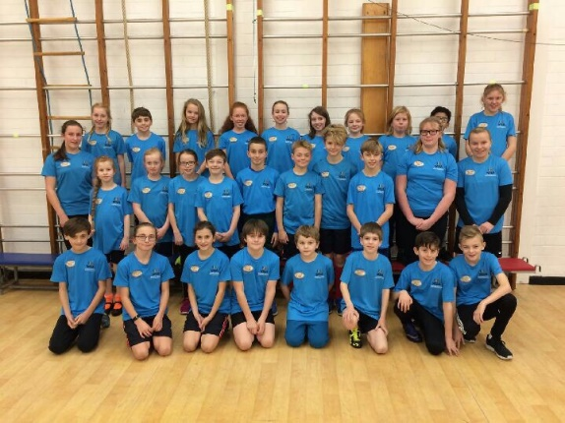
Other Opportunities
Legacy Leaders
( 3 or 4 children per school from year 5/6)
ECT Training 20th October and 18th May
PE Conference 20th February @The Regis School
Time to Dance week –(Week Beginning 20th March)

Slide 13
Awards
School Games Awards – National Award recognising PE and Sports provision at KS2
www.yourschoolgames.com
Quality Start Award- Sussex Award recognising PE and Sporting Provision at KS1
qualitystartaward.weebly.com

Slide 14
Communication
Weekly email (Please ensure we have your up to date contact details)
Competition entries via ‘Google docs’
Information on website –
Worthing School Sports Association - Home (WSSAPE.weebly.com)
Twitter: @WSSA_pe

